Slide 1
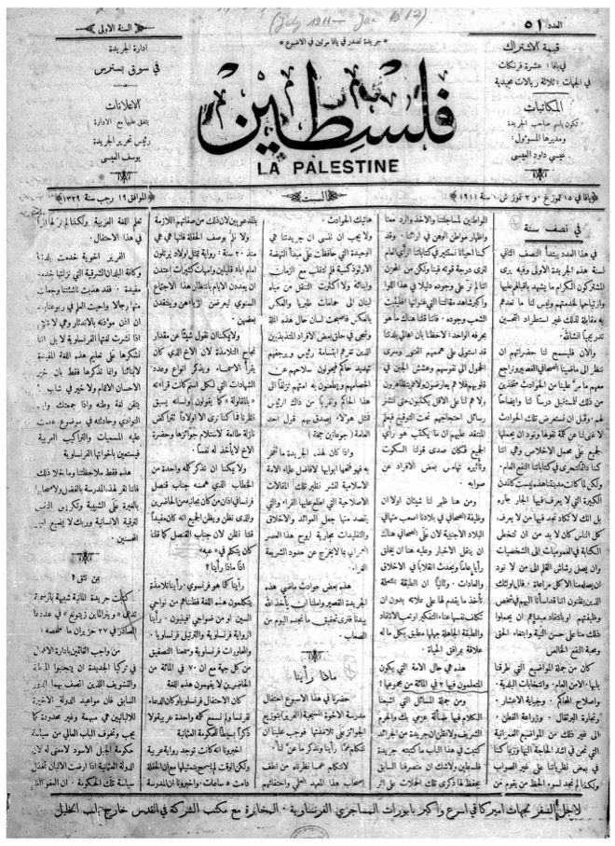
What are the origins of the Palestinian national movement?
Lesson 3

Slide 2
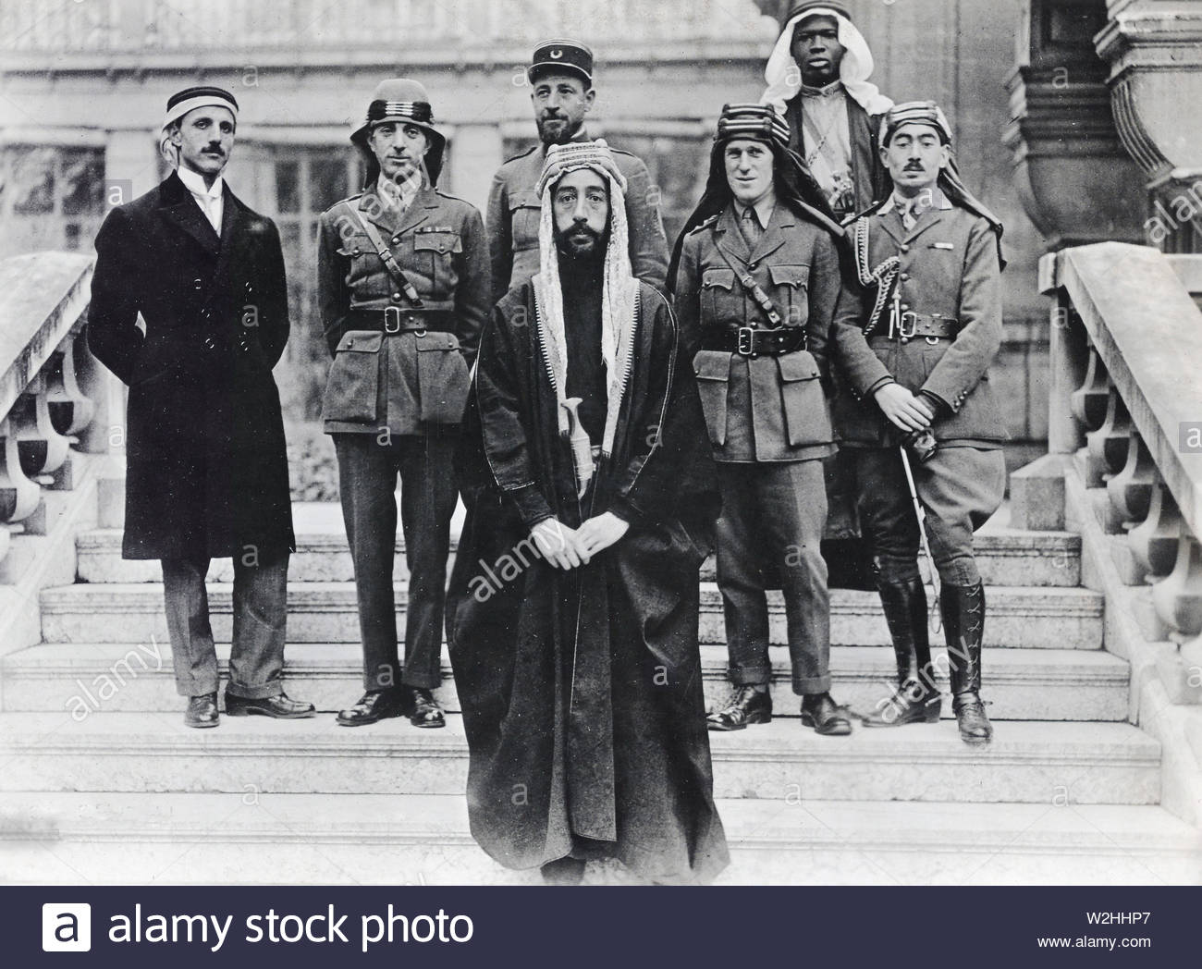
Learning objectives
By the end of this lesson, you should be able to:
Define nationalism
Explain the emergence of Palestinian nationalism
Compare the contradictory promises made by Britain during the First World War

Slide 3
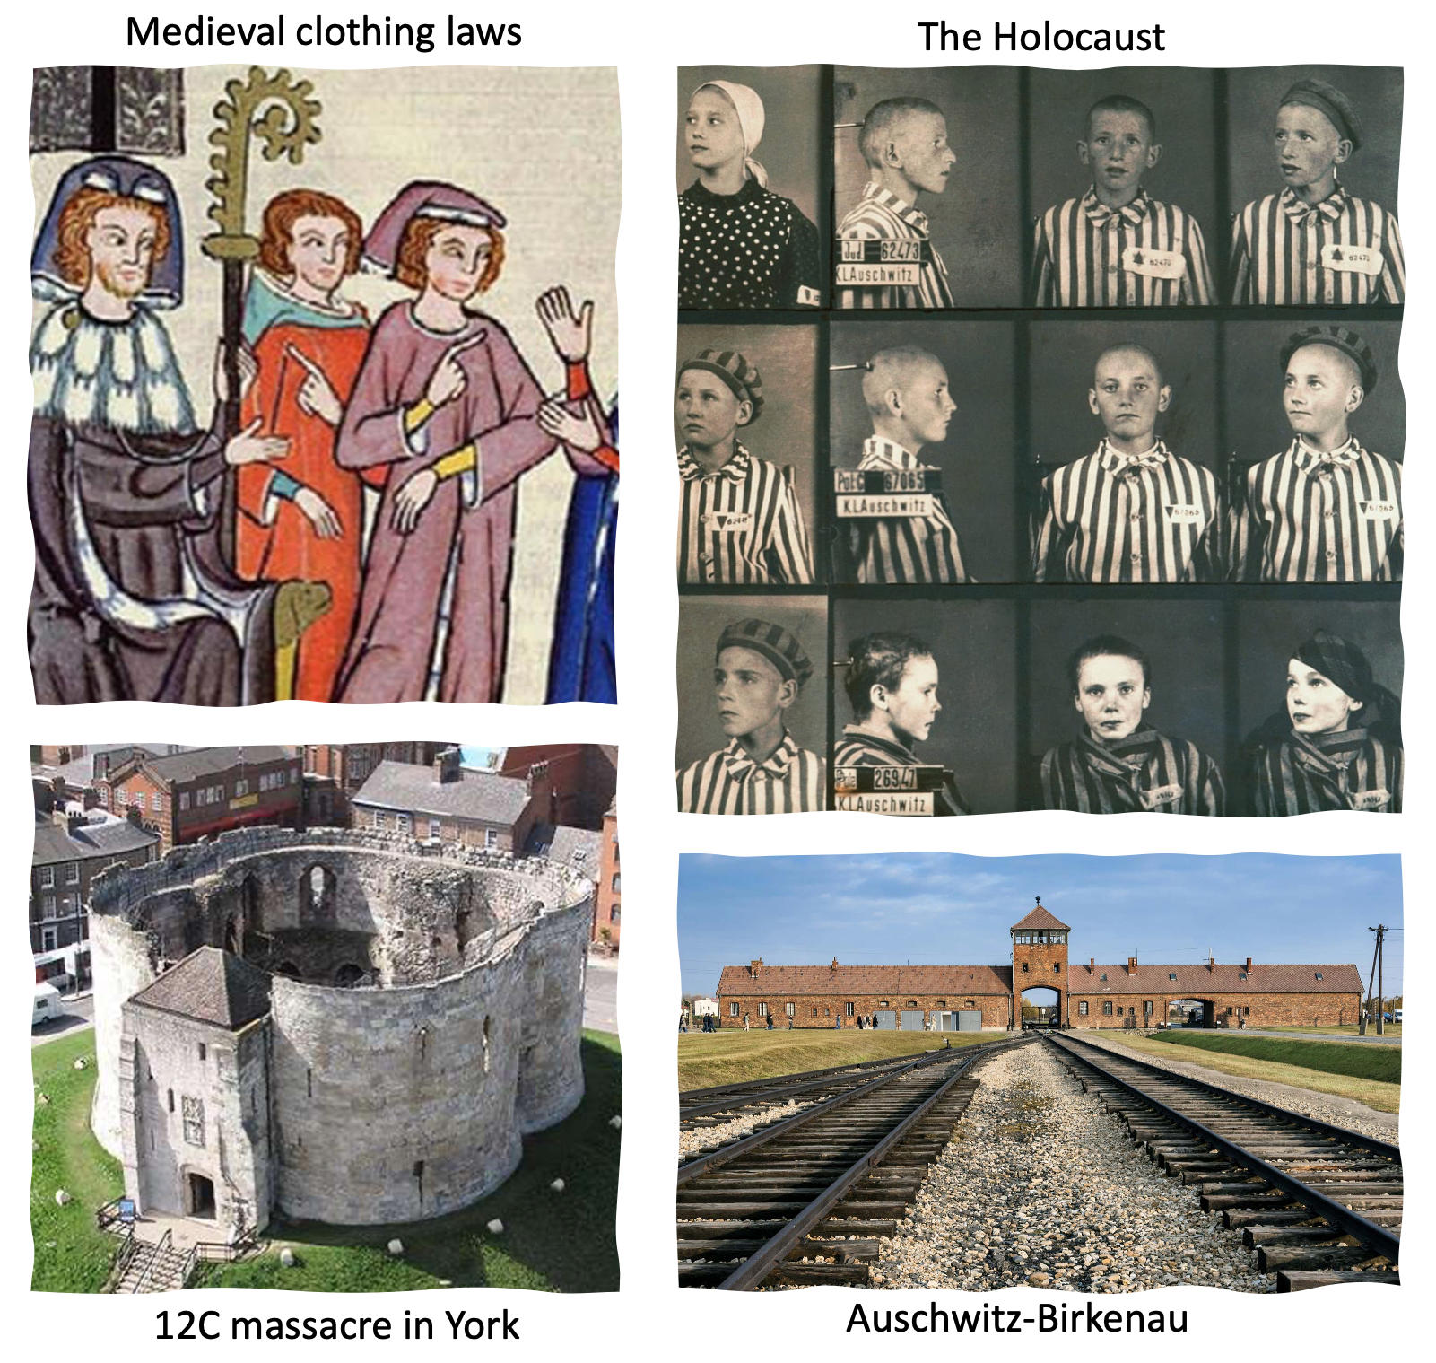
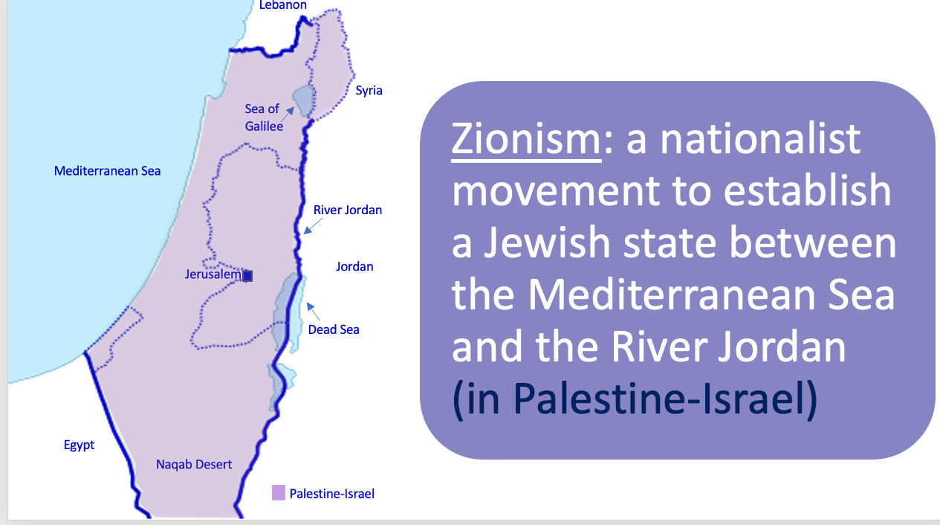
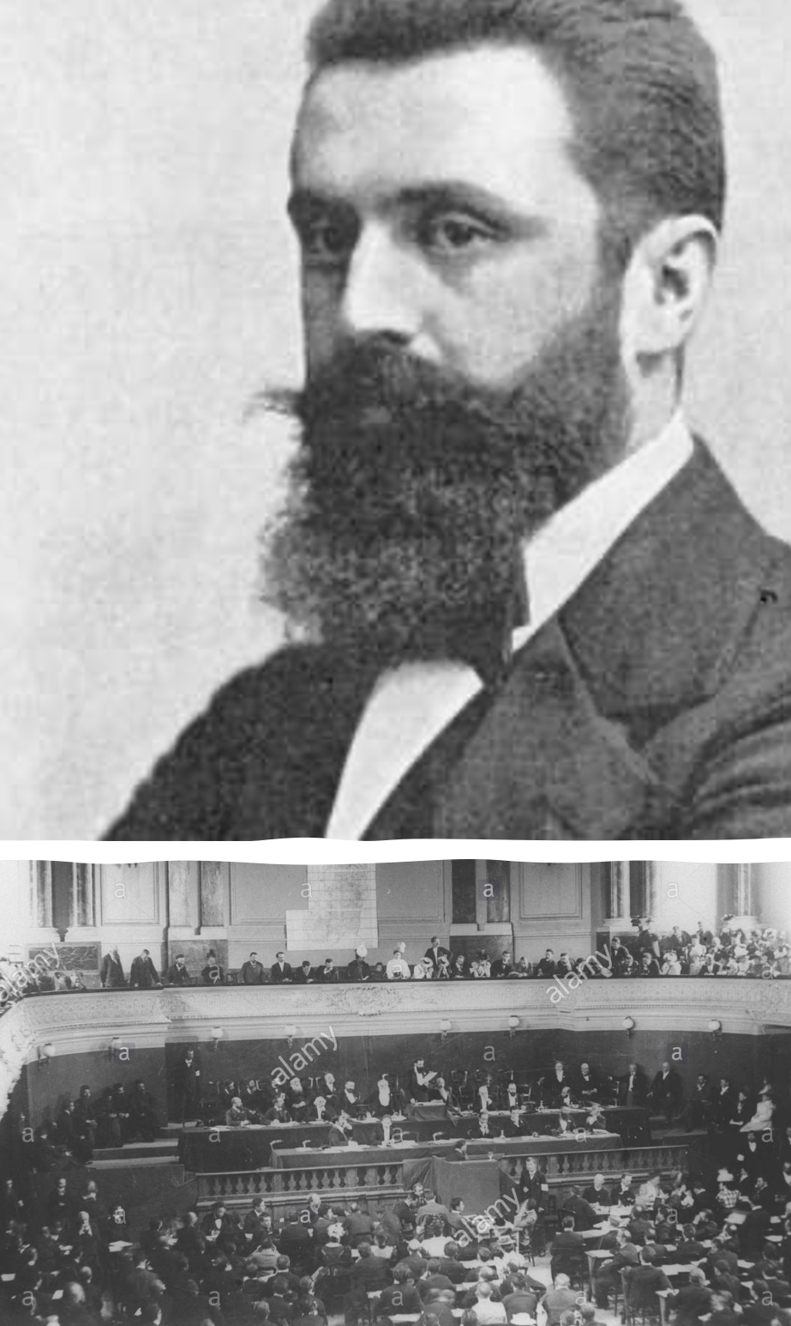
Thinking back to last lesson…
What is Zionism?
Why did Zionism emerge in the nineteenth century?
As a consequence of the long history of antisemitism and the Russian pogroms of the 1800s. Zionists were also inspired by other nationalist movements at this time
Why was this problematic for the Palestinians?
Because they lived in Palestine-Israel!

Slide 4
Starter activity
Think about these questions with the person next to you:
What is the difference between a nation, a country and a state?
Is Great Britain a nation, a country or a state?
Is England a nation, a country or a state?
How would you define nationalism?

Slide 5
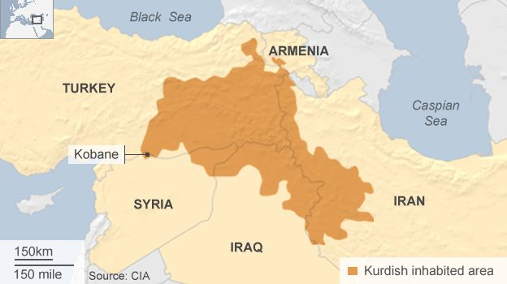
Nation, country, state
Kurdish national flag
Nation: a large group of people with common descent, history, culture or language
Country or state: a geographic space with a single government
Not every nation has a country or state, eg. the Kurds
Nationalism: the belief that one's country or state is distinct from and superior to others, and that it should govern itself
Nationalists are likely to be patriotic (to love their country)
Where Kurds live

Slide 6
Keywords - add these to your glossary!
Nationalism: the belief that one's country or state is distinct from and superior to others, and that it should govern itself
Arabs: an ethnic group who speak Arabic
Interesting fact: not all Arabs are Muslim, and only 20% of the world’s Muslims are Arabs.
Does this surprise you?

Slide 7
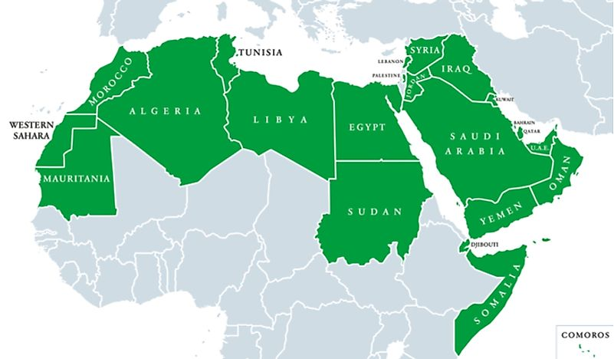
Arabic-speaking countries

Slide 8
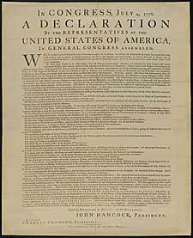
Nationalism
Nationalism: the belief that one's country or state is distinct from and superior to others, and that it should govern itself
Nationalism emerged in Britain during the Industrial Revolution, as people began to identify more with the country as a whole
Similar ideas developed in America at this time, contributing to opposition to unrepresentative British rule
The earliest examples of nationalism include the American Declaration of Independence (1776), and the French Revolution (1789) when people in France demanded to be ruled by a fairer, more representative government
These ideas also spread to Germany and Italy
As we saw last lesson, it was in this context of growing nationalism that the Jewish national movement of Zionism emerged in the nineteenth century. A national movement also emerged in the Arab world at this time, which we will explore shortly
Using this information, write a short paragraph explaining the emergence of nationalism in the nineteenth century. Provide at least one example

Slide 9
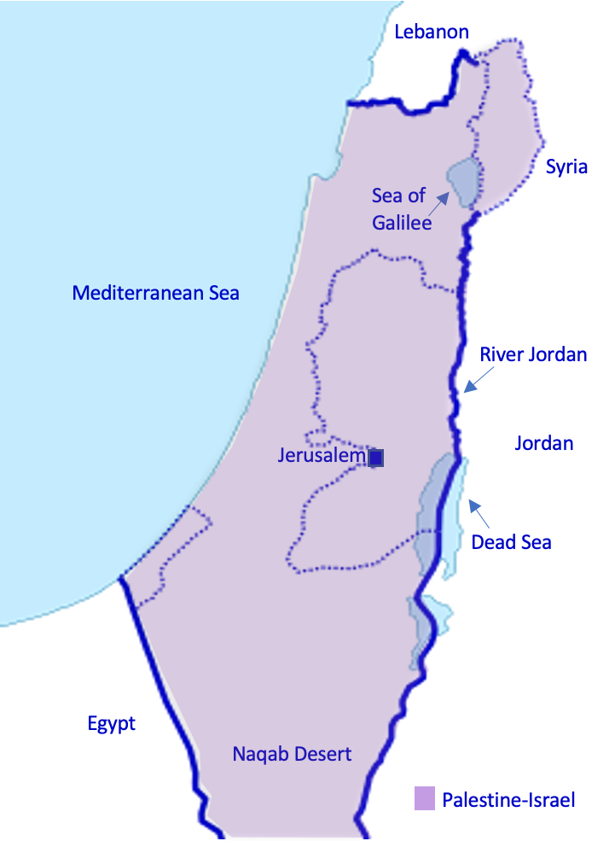
Palestinian and Arab identity in the nineteenth century
Palestinian
Someone who lived in the land of Palestine-Israel, which was then part of the Ottoman Empire
Arab
Someone who belonged to the Arab ethnic group and spoke Arabic

Slide 10
The rise of Arab and Palestinian nationalism
Nationalism: the belief that one's country or state is distinct from and superior to others, and that it should govern itself
Falastin: a Palestinian national newspaper established in 1911
Arab nationalism
The idea that Arabs are bound together by ethnicity, language and culture
First emerged among Arab intellectuals as a response to dissatisfaction with Ottoman rule in the 1800s
Became increasingly popular in the early 1900s, with the Young Arab Society, an Arab nationalist society established in 1911
Arab nationalists sought an independent Arab state, free from Ottoman rule
Palestinian nationalism
Closely related to Arab nationalism, but broke away in the early 1900s, partly due to the threat of Zionism
Palestinian nationalists sought an independent Palestinian state

Slide 11
3a. Fill in the blanks using these words:
Arab nationalism
1776
Zionism
2000
Palestinian nationalism
Nationalism
French Revolution
1789
American Declaration of Independence
Nationalism in Palestine-Israel
___________ is the belief that one's country or state is distinct from and superior to others, and that it should govern itself. Nationalism became increasingly popular in the late 1700s, with the ____________________________________ in ____ and the _________________ in ____.
In the 1800s, a Jewish nationalist movement emerged: _______. Zionists wished for Jews to return to Palestine-Israel where they had been expelled nearly ____ years ago.
At a similar time, as a response to Ottoman rule, ________________ emerged. After a while, due to the threat of Zionism, _____________________ broke away from Arab nationalism.
Therefore, at the start of the twentieth century, there were two competing nationalisms: Jewish nationalism (Zionism) and Palestinian nationalism. This is important background for understanding the promises made by Britain during the First World War.
Exchange your completed worksheet with the person sitting next to you

Slide 13
What do you already know about the First World War?

Slide 14
Nationalism and the First World War
July 1914 - November 1918
Allied powers: Britain, France, USA
Central powers: Germany, Austria-Hungary, Ottoman Empire
Trigger: assassination of Archduke Franz Ferdinand of Austria
What was the role of nationalism in WWI?
Nationalism led to high tensions between countries before the war, making the war more likely
It also caused countries to build up their armies, increasing their militarism (their ability to wage war)
More people signed up to fight for their country
The Ottoman Empire joined WWI on the side of the Central powers in October 1914
During the war, Britain made promises to both the Jews and the Palestinians about what would happen to Palestine-Israel if the Ottoman Empire lost the war. We are going to look at these promises next
When the Central powers lost the war, there was no one to govern the Ottoman Empire (including Palestine-Israel). We’ll be discussing what happened to Palestine-Israel next lesson

Slide 15
What do you know about the Balfour Declaration?

Slide 16
Key terms (add these to your glossary)
Balfour Declaration, November 1917: promised the British Government’s support for a ‘national home’ for the Jews in Palestine-Israel
Sykes-Picot Agreement, 1916: an agreement between Britain and France to divide the territories of the Ottoman Empire between them after the war, with Britain getting Palestine-Israel
Hussein-McMahon Correspondence, 1916: the British Government promised the Arabs that if they revolted against the Ottoman Empire, Britain would recognise an independent Arab state after the war
Can you see any problems with these promises?

Slide 17
For a short summary of these promises, watch 01.28-02.36
https://www.youtube.com/watch?v=Tz7JJcO-rWw&t=1s

Slide 18
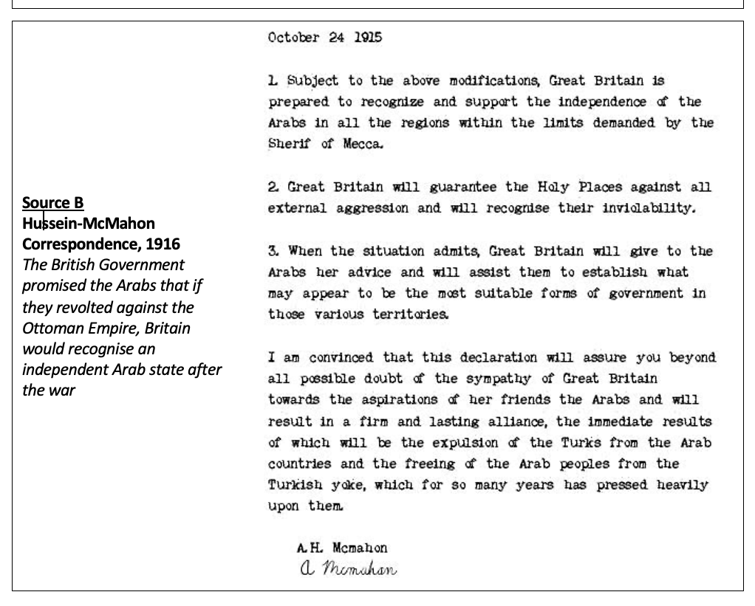
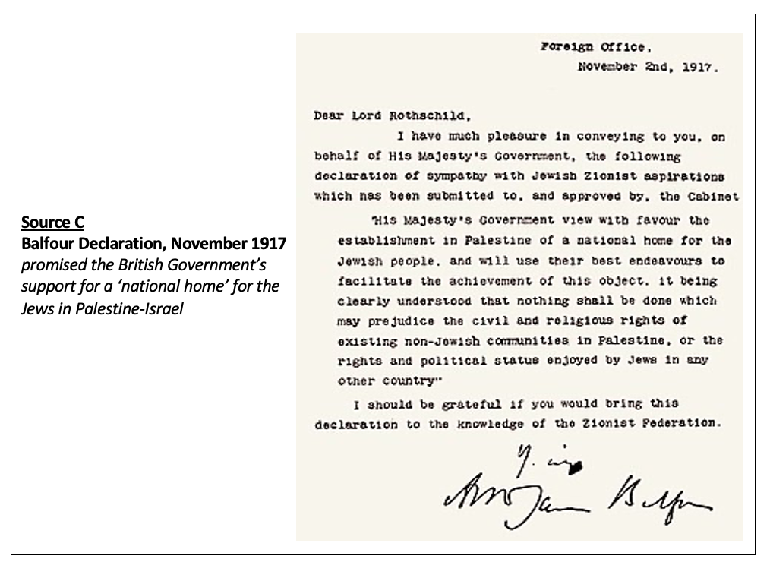
3b. Contradictory Promises: Primary Source Analysis
In small groups, read through the sources on worksheet 3b and answer the following questions:
What are the consequences of Source B for Arab nationalism? Highlight the key parts of the source
What was promised to the Jews in Source C? How would this make the Palestinians feel?
Can you spot any contradictions between these promises?

Slide 19
3b. Contradictory Promises: Primary Source Analysis
What are the consequences of Source B for Arab nationalism?

Slide 20
3b. Contradictory Promises: Primary Source Analysis
What is being promised to the Jews in Source C?
How would this make the Palestinians feel?
Further information:
This letter refers to the ‘existing non-Jewish communities in Palestine’, which was then 90% of the population
It refers to Palestinians’ ‘civil and religious rights’, but what about their political rights?

Slide 21
Homework
Promise | Jewish reaction | Palestinian reaction
Sykes-Picot Agreement, 1916
Hussein-McMahon Correspondence, 1916
Balfour Declaration, November 1917
Using worksheet 3b, make a table explaining how you would feel about each promise if you were Jewish or Palestinian

Slide 22
Plenary activity
What is nationalism? Can you name any famous examples?
What is Palestinian nationalism?
What three promises did the British make to the Jews and the Palestinians during WWI?
The belief that one's country or state is distinct from and superior to others, and that it should govern itself. Famous examples: The American Declaration of Independence (1776) and the French Revolution (1789)
The movement of the Palestinian people to govern Palestine-Israel
Sykes-Picot Agreement
Hussein-McMahon Correspondence
Balfour Declaration

